Slide 1


Divya Damodaran
December 16, 2025

Slide 2

Outline
Executive Summary
Introduction
Methodology
Results
Conclusion
Appendix

Slide 3
Executive Summary
Summary of methodologies
Data Collection
Data Wrangling
Exploratory Data Analysis with Data Visualization
Exploratory Data Analysis with SQL
Interactive Map building using Folium
Dashboard Build with Plotly Dash
Predictive Analysis(Classification)
Summary of all results
Exploratory Data Analysis Results
Interactive Analytics Demo Screenshots
Predictive Analysis Results

Slide 4
Introduction
Project background and context
Main focus of this project is to predict the successful landing of the Falcon 9 first stage. By accurately predicting landing success its easy to estimate launch costs and provide valuable insights for companies bidding against SpaceX.
Problems you want to find answers
How do variables such as payload mass, launch site, number of flights, and orbit type affect the success of the first stage landing?
How can we accurately predict the landing outcome using machine learning models
Which machine learning model performs best in predicting the landing success
Does the rate of success increase over the years?

Slide 5

Section 1

Slide 6
Methodology
Data Collection: First stage of SpaceX Falcon9 was collected mainly from SpaceX API and Web Scraping from Wikipedia Article
Data Wrangling: This process involved handling missing values, standardizing format.
Key features were extracted and new features engineered to enrich the dataset
Exploratory Data Analysis(EDA) :This process was performed using Visualization and SQL
Interactive Visual Analytics: Visual diagrams and dashboard were created using Folium and Plotly DASH
Predictive Analysis: Analysis was performed using Classification Algorithms on ML models
Github URL: ddivya2025/IBM-Applied-Data-Science-Capstone-Project

Slide 7
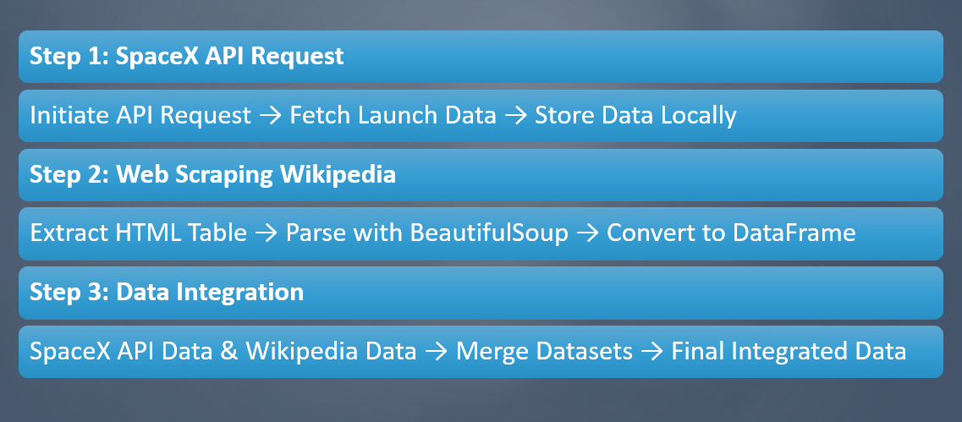
Data Collection

Slide 8
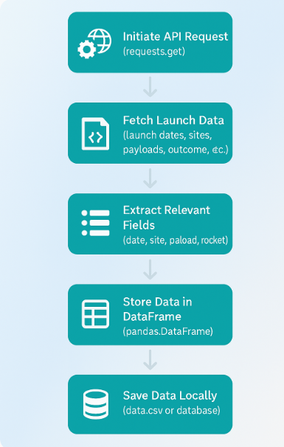
Data Collection – SpaceX API
Step 1: Initiate API Request
Use Python requests library to connect to SpaceX API.
https://api.spacexdata.com/v4/launches (Source URL)
Step 2: Initiate API Request
Convert JSON response to Python dictionary.Step 1: Initiate API Request
Extract key fields like launch date/Launch Site /Payload Mass/Rockey Type,/outcome
Step 3: Initiate API Request
Save data into a pandas DataFrame.
Export as CSV or store in a database for further analysis.
GitHub URL : 1.Data Collection API.ipynb

Slide 9
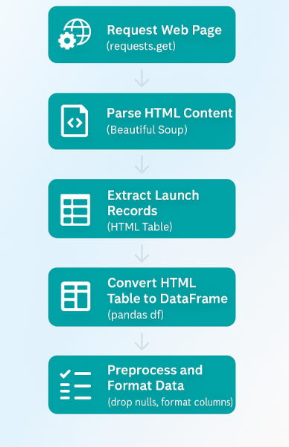
Data Collection – Web Scraping
Step1:Initiate Webscraping
Use Python’s request library to fetch HTML content from Wikipedia page
Source url: https://en.wikipedia.org/wiki/List_of_Falcon_9_and_Falcon_Heavy_launches
Step 2: Parse HTML page info
Use BeautifulSoup to parse the HTML content.
Extract the HTML table containing Falcon 9 launch records.
Step 3: Convert to Pandas DataFrame
Convert the extracted HTML table into a pandas DataFrame.
Clean and format the DataFrame, ensuring data consistency.
GitHub URL:2. Webscraping.ipynb

Slide 10
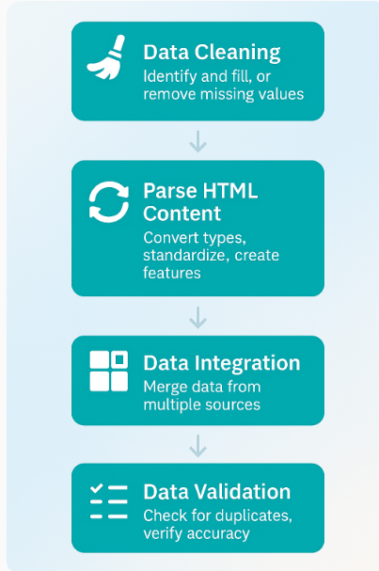
Data Wrangling
Step1:Data Cleaning
Identify and remove missing values from the dataset
Step2: Data Transformation
Convert data types to appropriate format
Create new features from existing data
Step3:Data Integration
Merge datasets collected from different sources like API
Web scraping etc into single dataset
Step4:Data Validation
Check for duplicates and remove if needed
Verify consistency and accuracy
GitHub URL:3. Data wrangling.ipynb

Slide 11
EDA with Data Visualization
These are the charts used in this project
1. Histograms
Purpose: Used to visualize the distribution of numerical variables such as launch success rates, payload mass, and flight number.
Why: Helps in understanding the spread and central tendency of the data, identifying outliers, and assessing data skewness.
2. Bar Charts
Purpose: Used to compare categorical variables such as launch outcomes (success/failure) across different categories like launch sites or rocket types.
Why: Provides a clear comparison of frequencies or proportions within categorical data, highlighting patterns or trends.
3. Line Charts
Purpose: Used to track trends over time, such as the success rate of Falcon 9 launches across different years.
Why: Reveals temporal patterns and helps in understanding performance trends or changes over specific periods.
GitHub URL:4. EDA with Data Visualization.ipynb
4.Scatter Plots
Purpose: Used to explore relationships between two numerical variables, such as payload mass vs. launch success.
Why: Identifies correlations or dependencies between variables, visualizing how one variable changes concerning another.
5. Heatmaps
Purpose: Used to visualize correlation matrices between multiple numerical variables.
Why: Helps in identifying strong correlations (positive or negative) between variables, aiding feature selection or understanding multicollinearity.
6. Box Plots
Purpose: Used to display the distribution of numerical data through their quartiles.
Why: Visualizes the spread and skewness of data, highlighting outliers and comparing distributions across different categories.

Slide 12
EDA with SQL
Aggregate Queries
Calculated total number of launches.
Counted successful and failed launches.
Calculated success rates by launch site and rocket type.
Join Queries
Joined tables to link launch records with additional data (e.g., rocket details).
Combined datasets for comprehensive analysis.
Filtering Queries
Filtered data to focus on specific launch outcomes (success/failure).
Applied conditions to extract launches based on criteria like launch date or rocket configuration.
Sorting Queries
Sorted data to identify trends or outliers.
Ordered launches by date or success rate for analysis.
Subqueries
Nested queries to calculate derived metrics (e.g., average payload mass per launch site).
Subqueries used to perform detailed analysis within larger datasets.
GitHub URL:5. EDA with SQL.ipynb

Slide 13
Build an Interactive Map with Folium
Reasons for Adding Them
Markers help pinpoint and identify launch locations geographically
Circles visualize potential impact areas, safety zones, or operational boundaries
Lines show spatial relationships, connections, or dependencies between locations
GitHub 6. Interactive Visual Analytics with Folium.ipynb
These Objects Used
Markers
Indicate exact launch site locations
Each marker represents a real geographic point where SpaceX launches occurred
Circles
Drawn around launch sites
Represent proximity or surrounding zones that may affect operations
Lines
Connect launch sites to nearby or related locations
Provide spatial context between different points of interest
Explain why you added those objects

Slide 14
Build a Dashboard with Plotly Dash
Dash
Functions from Dash are used to generate an interactive website.
Interactions added - Users can toggle inputs using:
Launch site dropdown menu
Range slider for Payload mass
The interactive site uses:
A pie chart
A scatter plot
The site displays:
The total number of successful launches from each launch site
The correlation between payload mass and mission outcome (success or failure) for each launch site
GitHub URL:7. spacex dash app.py

Slide 15
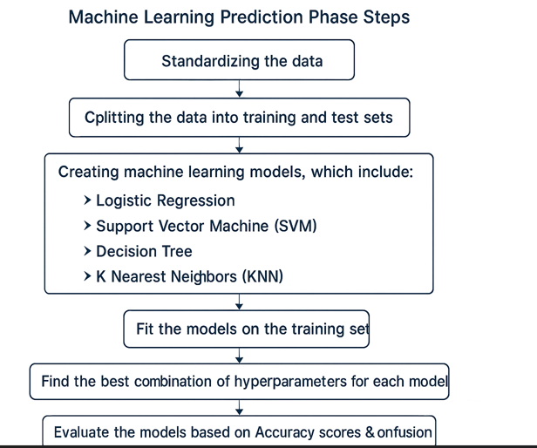
Predictive Analysis (Classification)
Machine Learning Prediction Phase Steps:
Standardizing the data
Splitting the data into training and test sets
Creating machine learning models, which include:
Logistic Regression
Support Vector Machine (SVM)
Decision Tree
K Nearest Neighbors (KNN)
Fit the models on the training set
Find the best combination of hyperparameters for each model
Evaluate the models based on Accuracy scores & Confusion matrix
GitHub URL:8. Machine Learning Prediction.ipynb

Slide 16
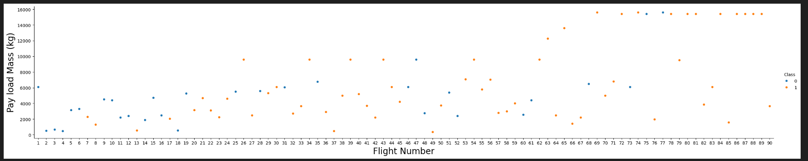
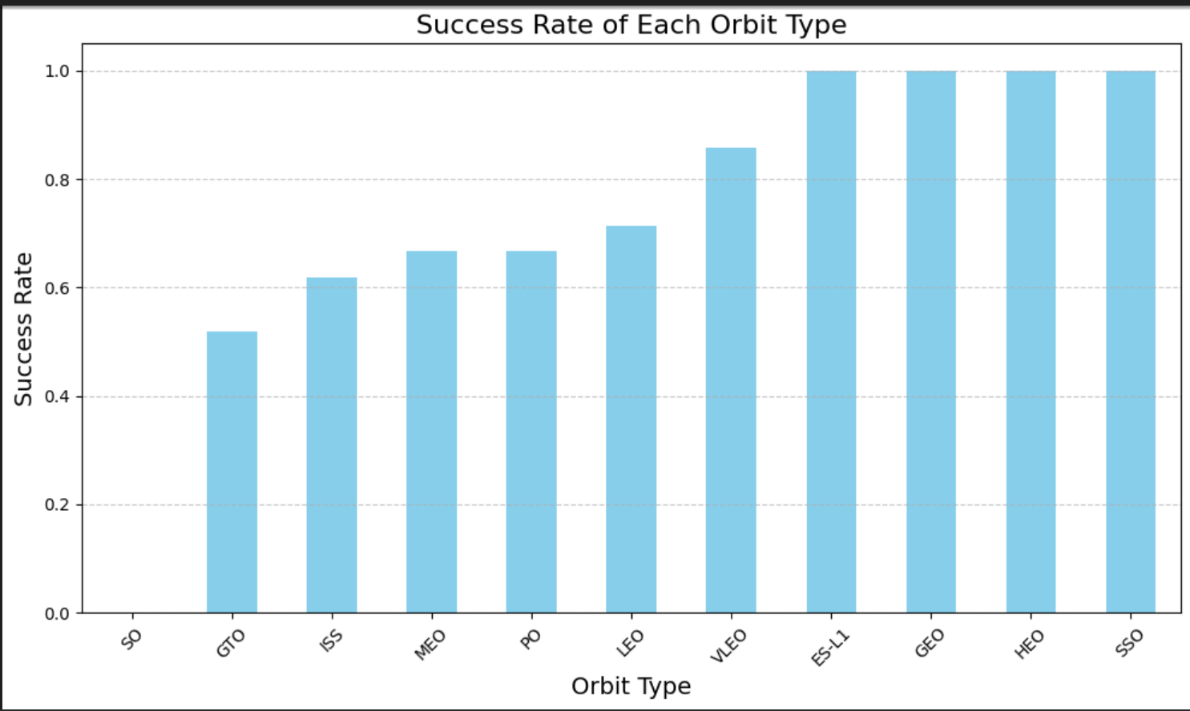
Results
Exploratory data analysis results

Slide 17
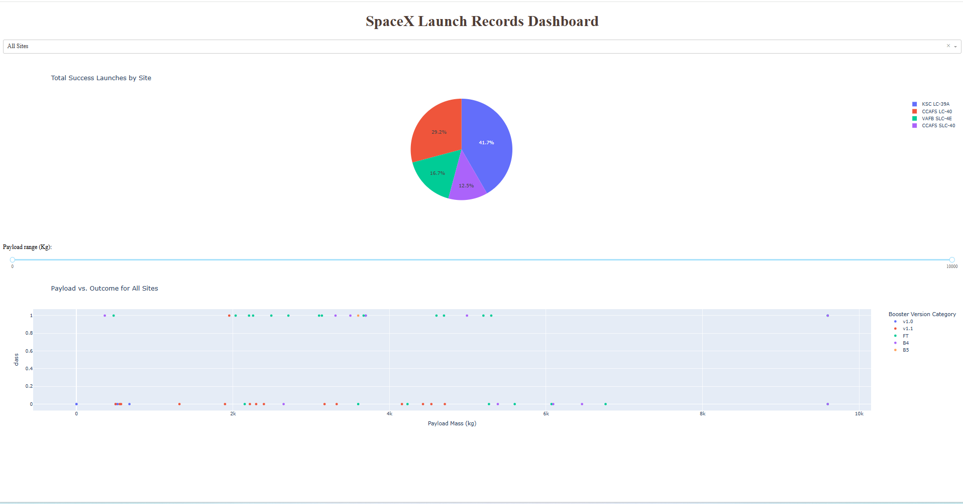
Results cont’d
Interactive analytics demo in screenshots

Slide 18
Results cont’d
Predictive analysis results:
Libraries or modules used:
pandas, numpy, matplotlib.pyplot, seaborn, sklearn
The machine learning prediction phase include the following steps:
Standardizing the data using the preprocessing.StandardScaler() function from sklearn
Splitting the data into training and test data using the train_test_split function from sklearn.model_selection
Creating machine learning models, which include:
Logistic regression using LogisticRegression from sklearn.linear_model
Support vector machine (SVM) using SVC from sklearn.svm
Decision tree using DecisionTreeClassifier from sklearn.tree
K nearest neighbors (KNN) using KNeighborsClassifier from sklearn.neighbors
Fit the models on the training set

Slide 19
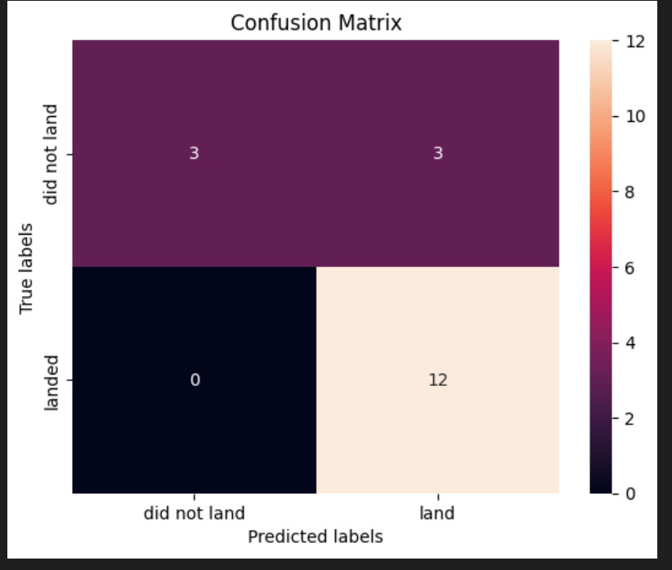
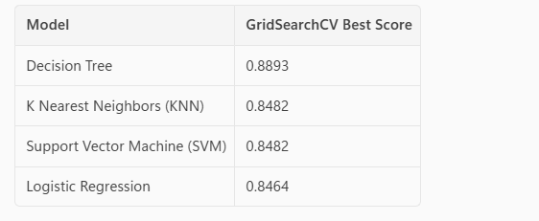
Results cont’d
Predictive analysis results:
Find the best combination of hyperparameters for each model using GridSearchCV from sklearn.model_selection
Evaluate the models based on their accuracy scores and confusion matrix using the score() function and confusion_matrix from sklearn.metrics
Putting the results of all 4 models side by side, we can see that they all share the same accuracy score and confusion matrix when tested on the test set. Based on the GridSearchCV best scores, the models are ranked in the following order with the first being the best and the last one being the worst:

Slide 20

Section 2

Slide 21
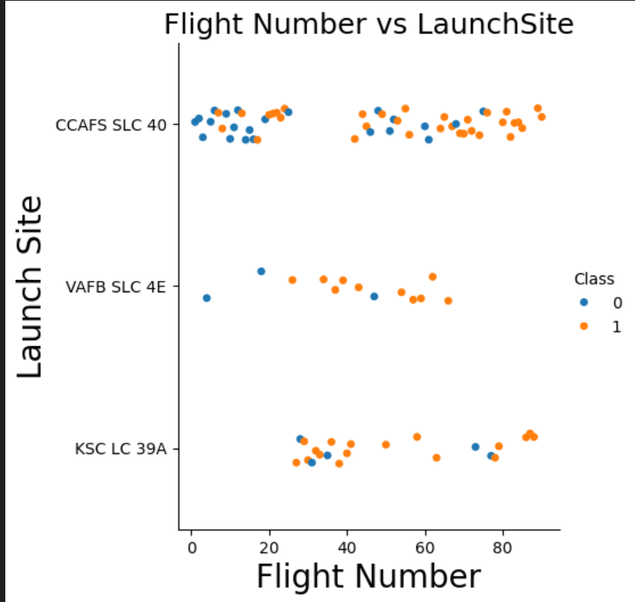
Flight Number vs. Launch Site
Observations
Success rate (class=1) increases as number of flights increases
Launch site ‘KSC LC 39A’ it took around 25 launches before the 1st success

Slide 22
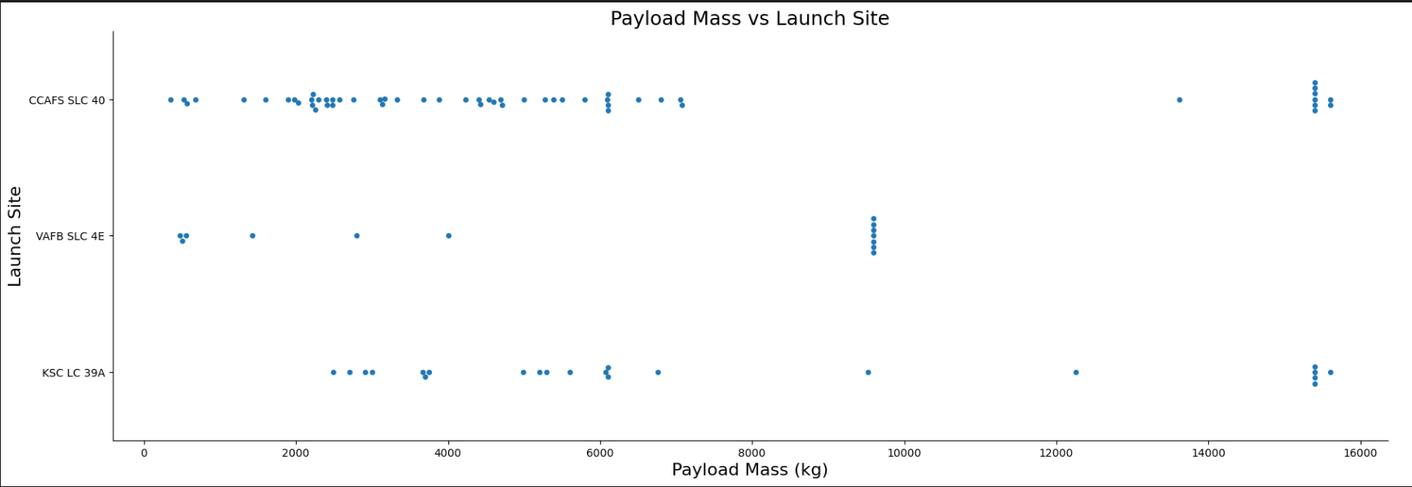
Payload vs. Launch Site
Observations
For ‘VAFB SLC 4E’ there were no rockets launched for payload greater than 10,000kg
There is no clear correlation /pattern between launch site and payload mass

Slide 23
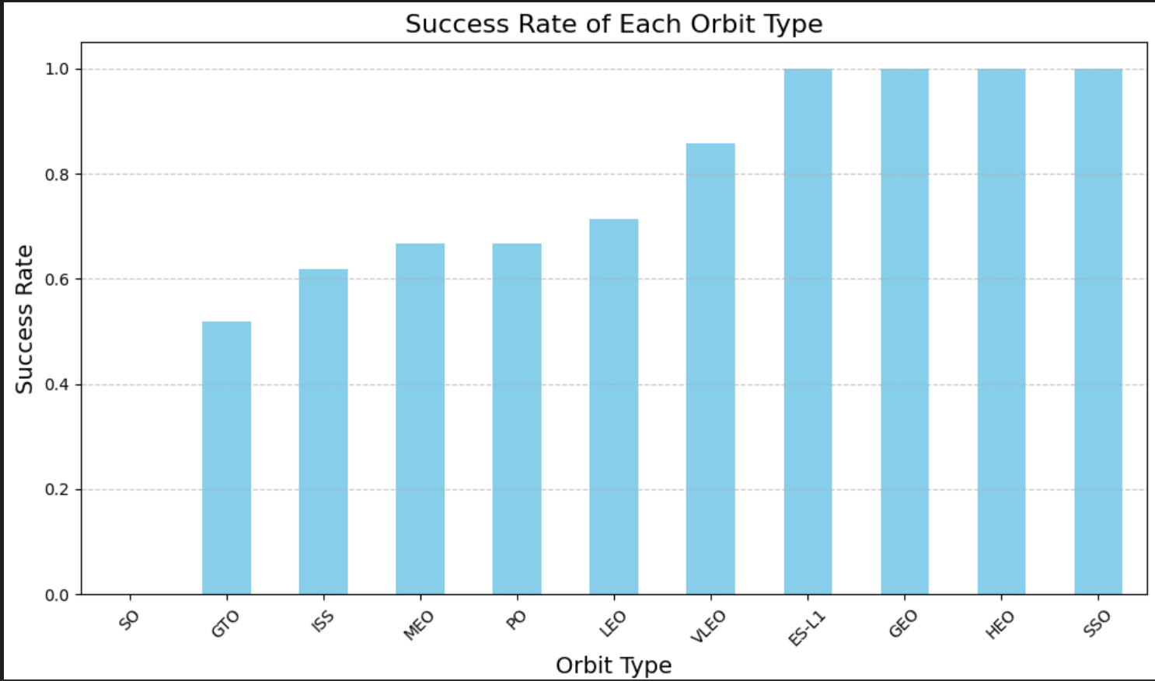
Success Rate vs. Orbit Type
Observations
Orbit types ES-L1, GEO, HEO, and SSO have high success rates
GTO orbit type has the lowest success rate

Slide 24
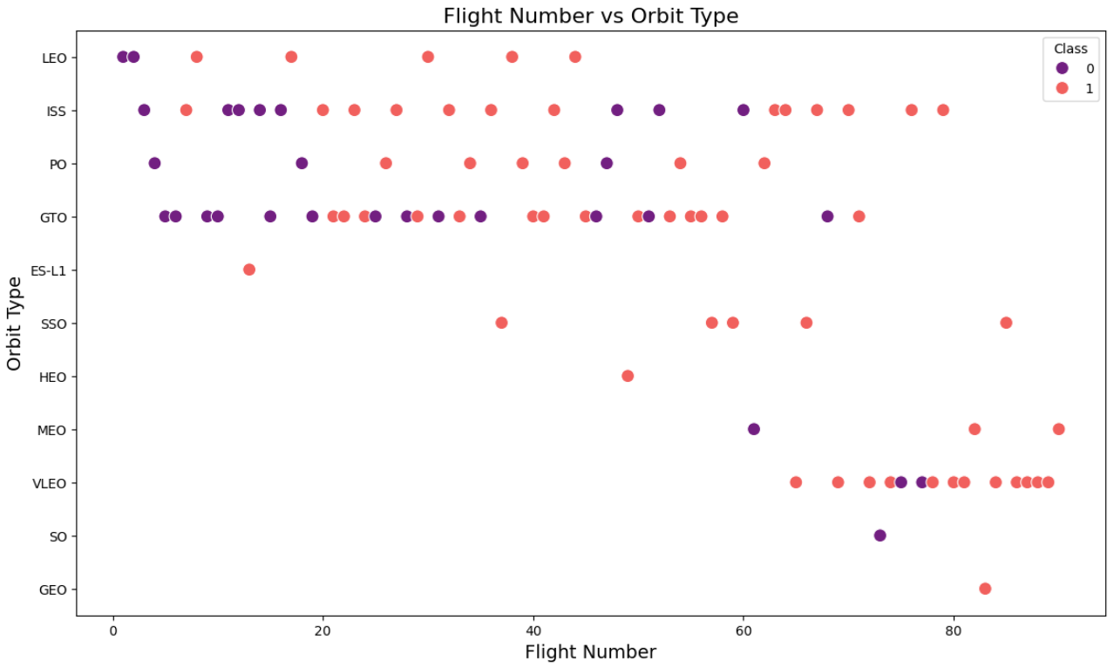
Flight Number vs. Orbit Type
Observations
Leo orbit success tie to number of flights
GTO Orbit has no relationship between flight number and success

Slide 25
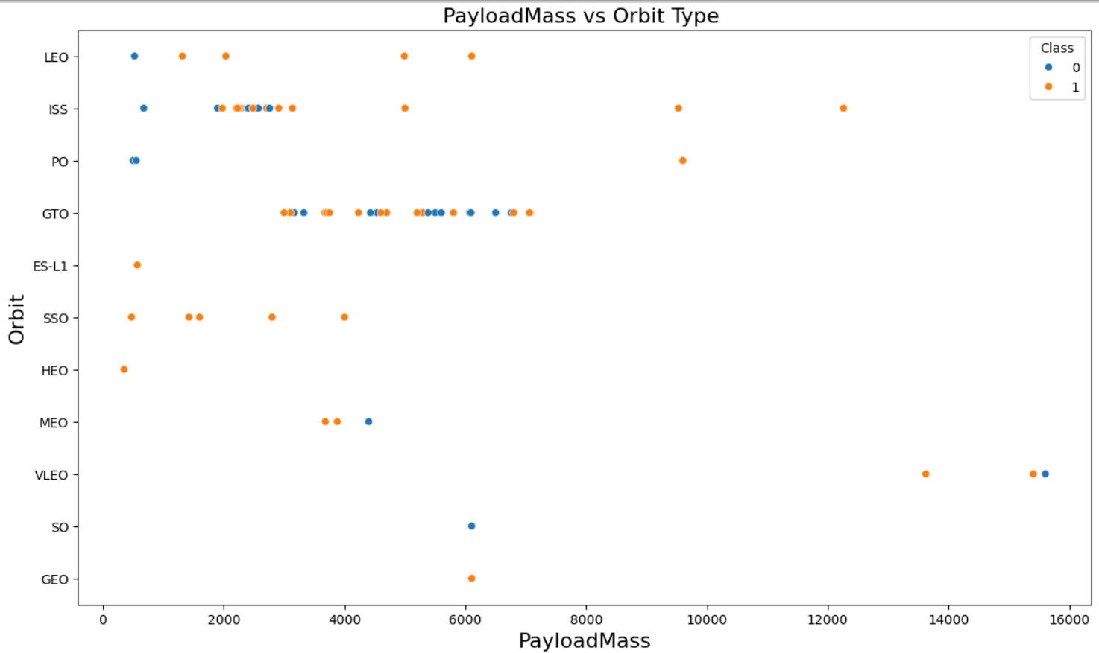
Payload vs. Orbit Type
Observations
Successful landing/positive landing rate more for Polar, LEO and ISS
For GTO its difficult to distinguish between successful and unsuccessful landings as both outcomes are present

Slide 26
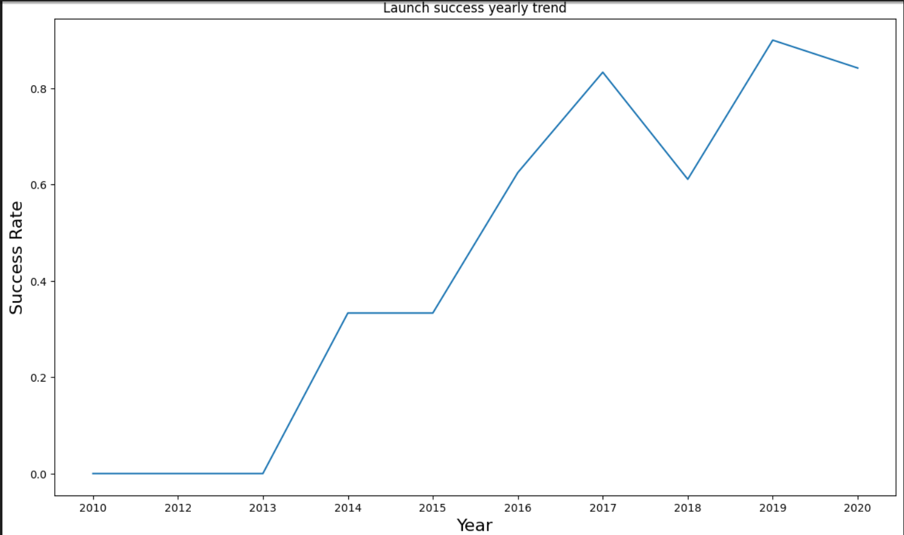
Launch Success Yearly Trend
Observations
Success rate keep increasing between 2013 and 2020
Success rate remained same between 2010 and 2013 /2014 and 2015
Success rate decreased between 2017 and 2018/2019 and 2020

Slide 27
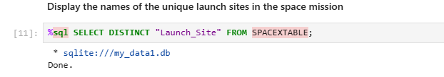
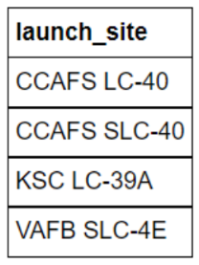
All Launch Site Names
Query for launch sites list
Result:

Slide 28
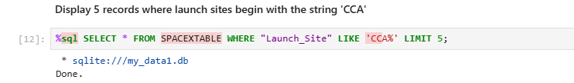
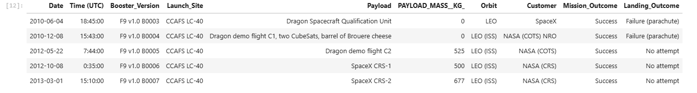
Launch Site Names Begin with 'CCA'
Query for launch site begins with ‘CCA’
Result:

Slide 29
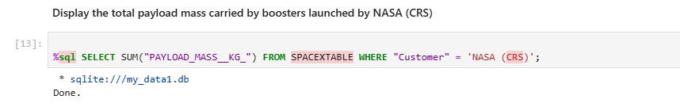

Total Payload Mass
Query for payload mass launched by NASA
Result:

Slide 30
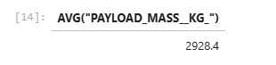
Average Payload Mass by F9 v1.1
Query for average payload mass carried by booster version F9 v1.1
Result:

Slide 31
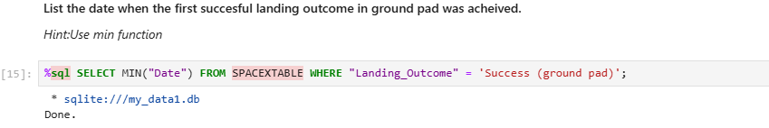

First Successful Ground Landing Date
Find the dates of the first successful landing outcome on ground pad
Result:

Slide 32
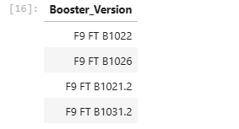
Successful Drone Ship Landing with Payload between 4000 and 6000
Query :List the names of boosters which have successfully landed on drone ship and had payload mass greater than 4000 but less than 6000
Result:

Slide 33

Total Number of Successful and Failure Mission Outcomes
Query:Calculate the total number of successful and failure mission outcomes
Result:

Slide 34
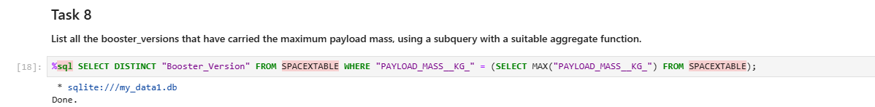
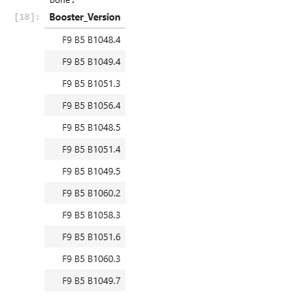
Boosters Carried Maximum Payload
Query: List the names of the booster which have carried the maximum payload mass
Result

Slide 35
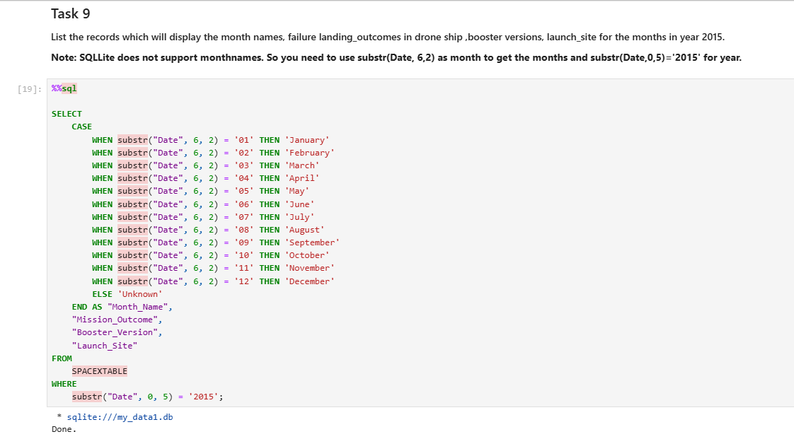
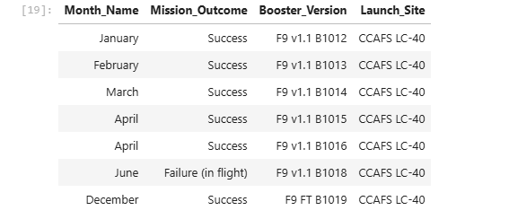
2015 Launch Records
List the failed landing_outcomes in drone ship, their booster versions, and launch site names for in year 2015
Result :

Slide 36
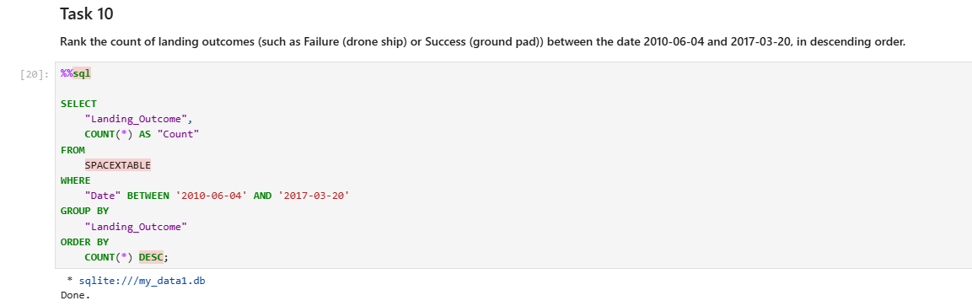
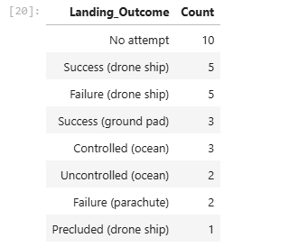
Rank Landing Outcomes Between 2010-06-04 and 2017-03-20
Rank the count of landing outcomes (such as Failure (drone ship) or Success (ground pad)) between the date 2010-06-04 and 2017-03-20, in descending order
Result:

Slide 37

Section 3

Slide 38
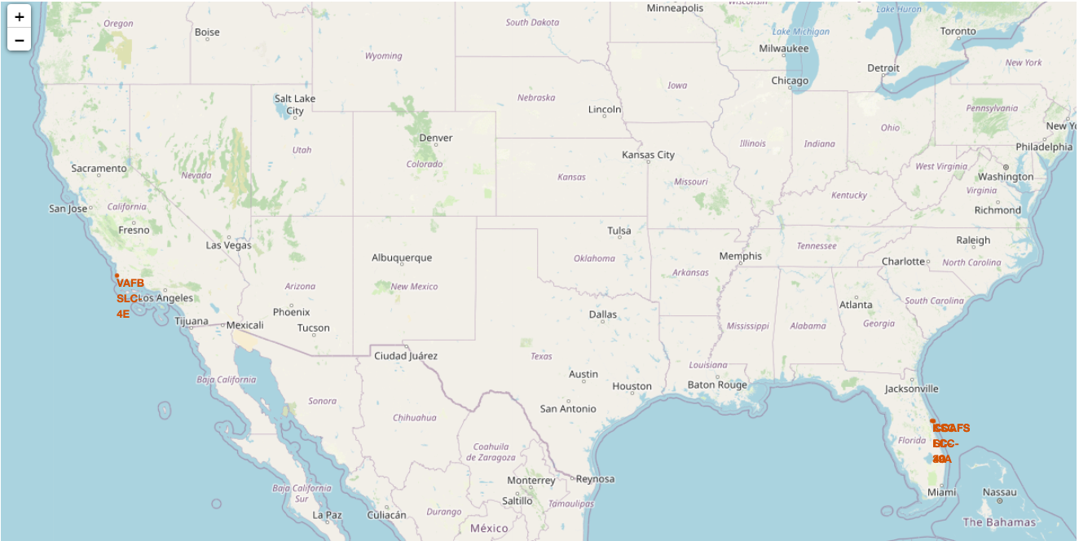
SpaceX Falcon9 Launch Sites Map
Observation: Figure displays global map with Falcon9 launch sites that are located in California & Florida. Each site highlights the location and name of the launch site.

Slide 39
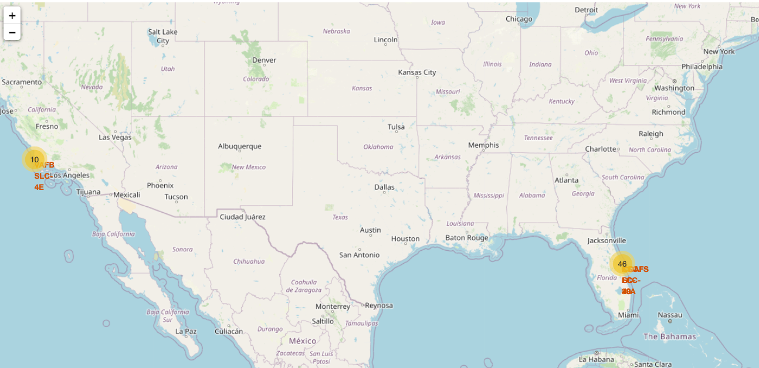
SpaceX Falcon9 – Success/Failure Launch site Map

Slide 40
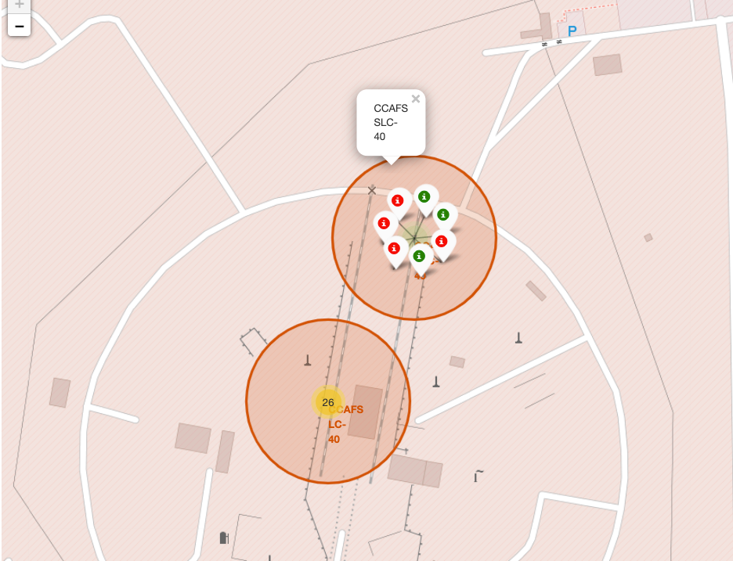
SpaceX Falcon9 – Success/Failure Launch Map –Cont’d
Observation : Zooming a specific launch site we can see green and red tags. Each green tag mean successful launch where red one represents failed launch

Slide 41
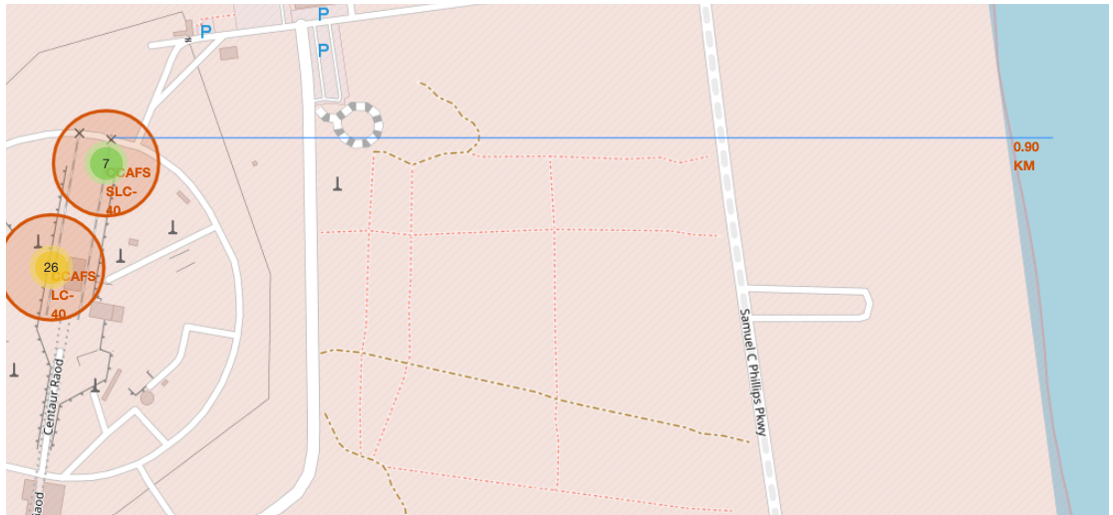
SpaceX Falcon9 – Launch Site Proximity Map
Observation:Figure shows distance between launch site and nearest coastline

Slide 42

Section 4

Slide 43
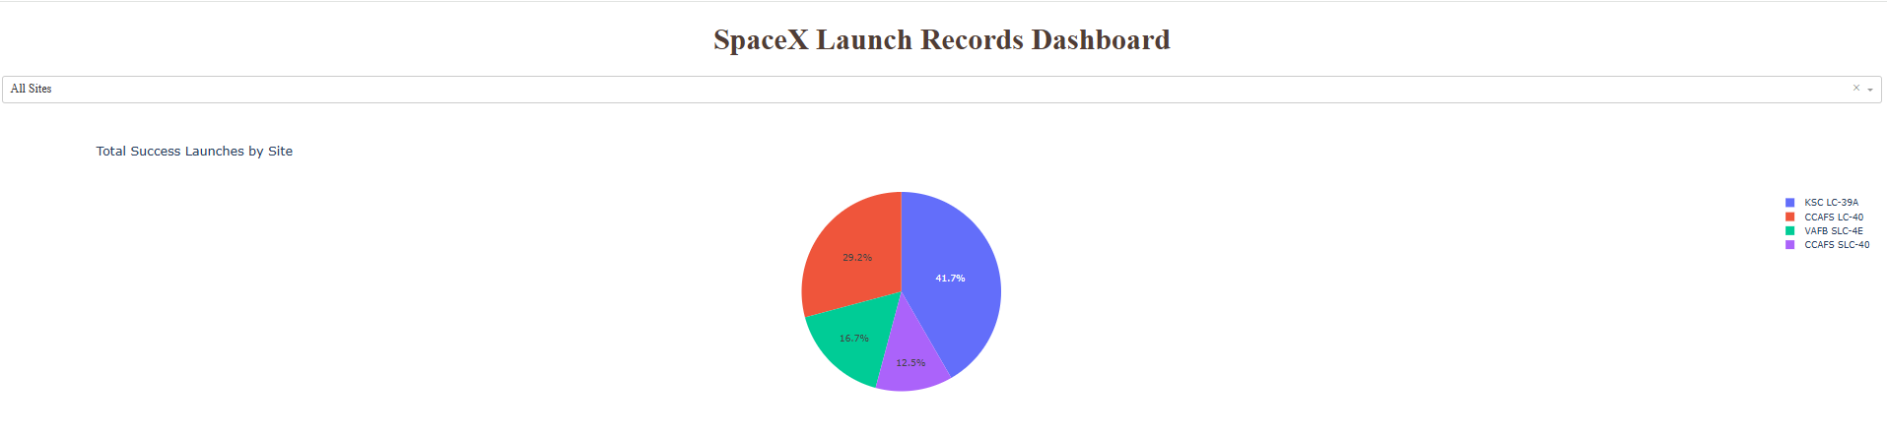
All Sites – Launch Success
Launch site ‘KSC LC-39A’ has the highest launch success rate
Launch site ‘CCAFS SLC-40’ has the lowest launch success rate

Slide 44
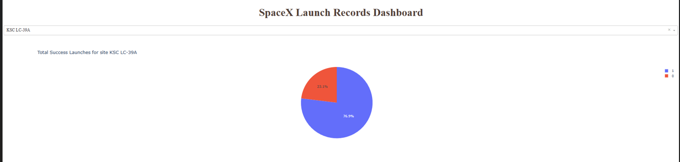
Launch Site – Highest Launch Success Rate
Launch site ‘KSC LC-39A’ has highest success rate 76.9% and failure rate 23.1%

Slide 45
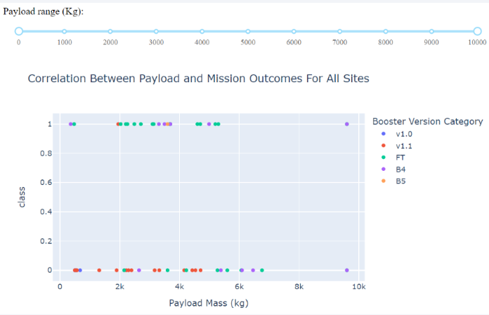
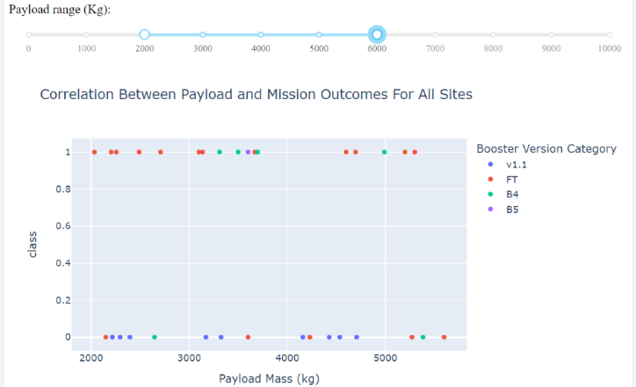
Payload Vs Launch Outcome
Observation: Successful launches falls under payload mass range 2000 - 5500

Slide 46

Section 5

Slide 47
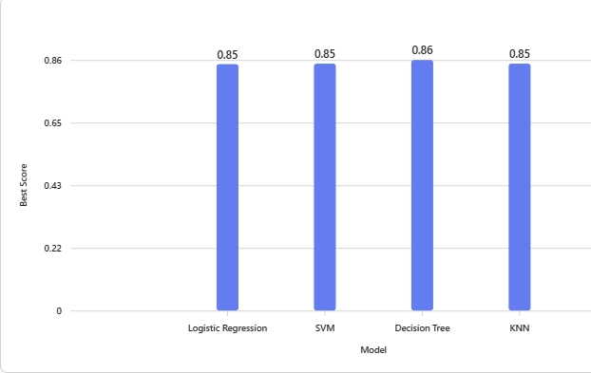
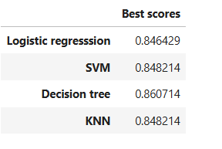
Classification Accuracy
Based on the accuracy score and evidence from bar chart ‘Decision Tree algorithm’ has highest classification score

Slide 48
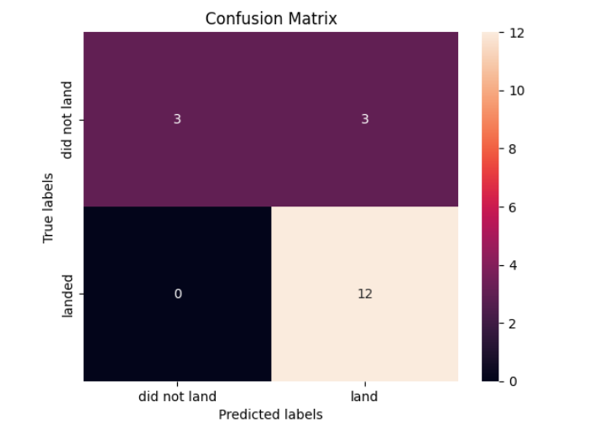
Confusion Matrix
In general classifier is correctly predicted for about 83.4% of the time (True positive + True Negative /Total = 12 + 3 /18) and error rate 16.6% (False Positive + False Negative /Total = 3+0 /18)

Slide 49
Conclusions
Insight #1: The study successfully predicted Falcon 9 first-stage landing outcomes using launch and mission features, helping estimate launch costs.
Insight#2 :Landing and launch success rates improved significantly over time (≈80% from 2013–2020)
Insight#3:Success varies by launch site and orbit type, while payload mass shows no strong correlation with landing success.
Insight#4:The Decision Tree model performed best among all models, achieving ~83% accuracy on test data, with potential for improvement using more data.

Slide 50


